Slide 1
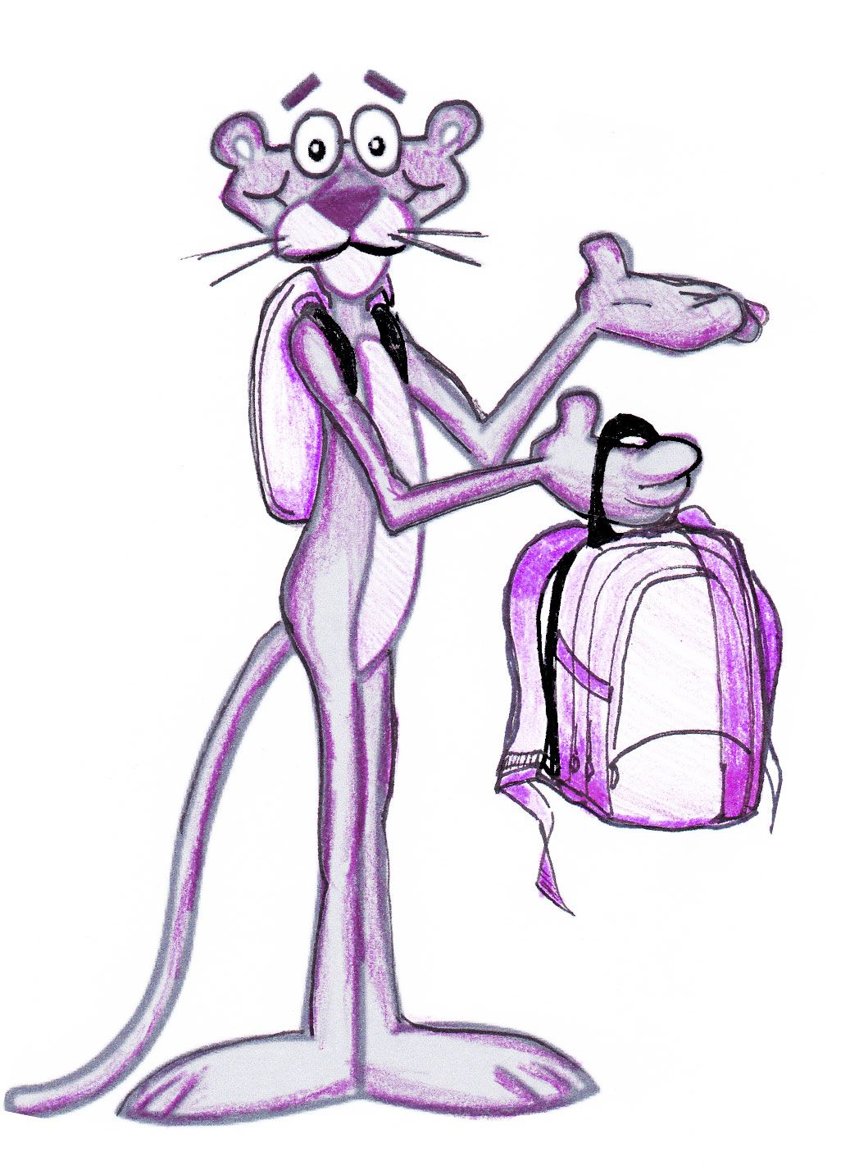
Backpack Awareness
A Collaboration between the PTSA & LWSD
Notes:
goal:share what we’ve done and invite your school to participate

Slide 2
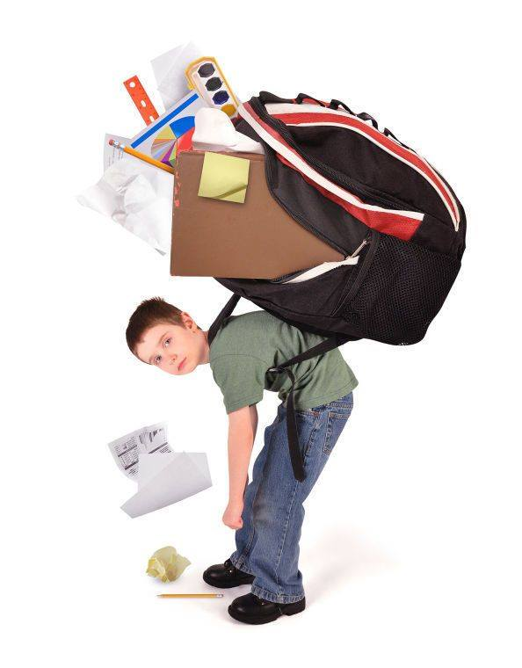
Notes:
Why is this important? Some kids carring 1/3 of their wt (45 pounds for me) Growing Bodies not designed. Impacts on posture- out of alignment. Most disparity in middle school kids (size vs expected loads to carry)

Slide 3
Kirkland Middle School: Backpack Committee
Started Spring 2015
  Parent Concern
  Backpack Awareness Day
  Problem Scoped, Solutions Identified
Presented to LWSD Spring 2016
  Why is this important?
  Gained Dr. Pierce’s support
    AOTA: “A backpack should not weigh more than 10-15% of student’s bodyweight”
Notes:
National BPA Day (AOTA)- Kids have fun! platform for edu and gathering data, relevant sample size, 16.1 lbs avg in 2015

Slide 4
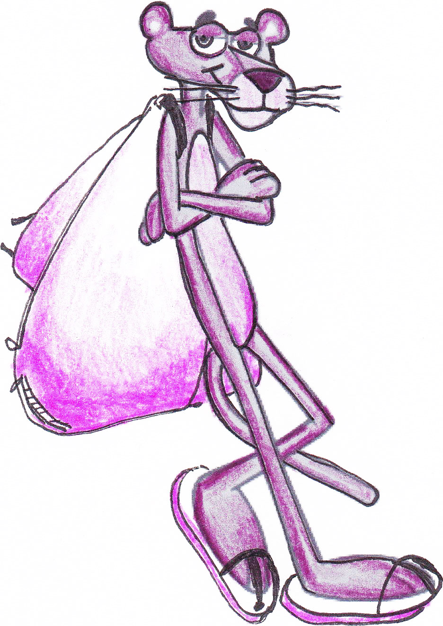
Working in Partnership
Committee meets with LWSD every other month
Review goals and ideas
  Short term
  Long term
  Celebrate Successes
    KiMS has shed 1.5 pounds from ‘15 to ‘16
Notes:
Cultivating relationship, district would like more faces at the table

Slide 5
Successes to Date
Kirk Elementary 5th graders were provided education on Backpack awareness by committee volunteers
KiMS committee met with KiMS students and staff for ideas
Education materials were made available by the committee to KiMS students, parents and staff
KiMS created a new, lighter supply list for 2016-17
2016-17 student planner reduced in weight/size
KiMS Math department de-spined workbooks, and used lighter plastic binders
Backpack clean-outs were implemented at KiMS
KiMS/LWSD added 2 water filling stations at school so students won’t need to carry full bottles to school
Teachers at KiMS provided more storage in some classrooms to reduce what students had to carry
LWSD Communications Department initiated “Pack it light, check at night” campaign on social media and in district publications targeting parents, students and staff
“Tips for Purchasing a Backpack” from AOTA was posted on LWSD Website and Social Media
LWSD Principals were provided with article and resources to share in newsletters
LWSD Communications Department provided poster masters for use at schools
At the 2016 KiMS weigh-in, the average backpack was reduced to 14.6 pounds from 16.1 in 2015
Notes:
Just a visual slide of how much has been done, will highlight one or two of these

Slide 6
Broadening the Scope District-Wide
Share what we’ve learned
  Utilize district level support
Two Years of Work
  Ongoing/continuous effort
  Improvement over time
  Need more voices at the table
  Backpack Awareness Day at your School
    Consistency in process
Is backpack weight a concern at your school?
Notes:
No silver bullet solution/ talk to parents, principal, Each school is unique

Slide 7
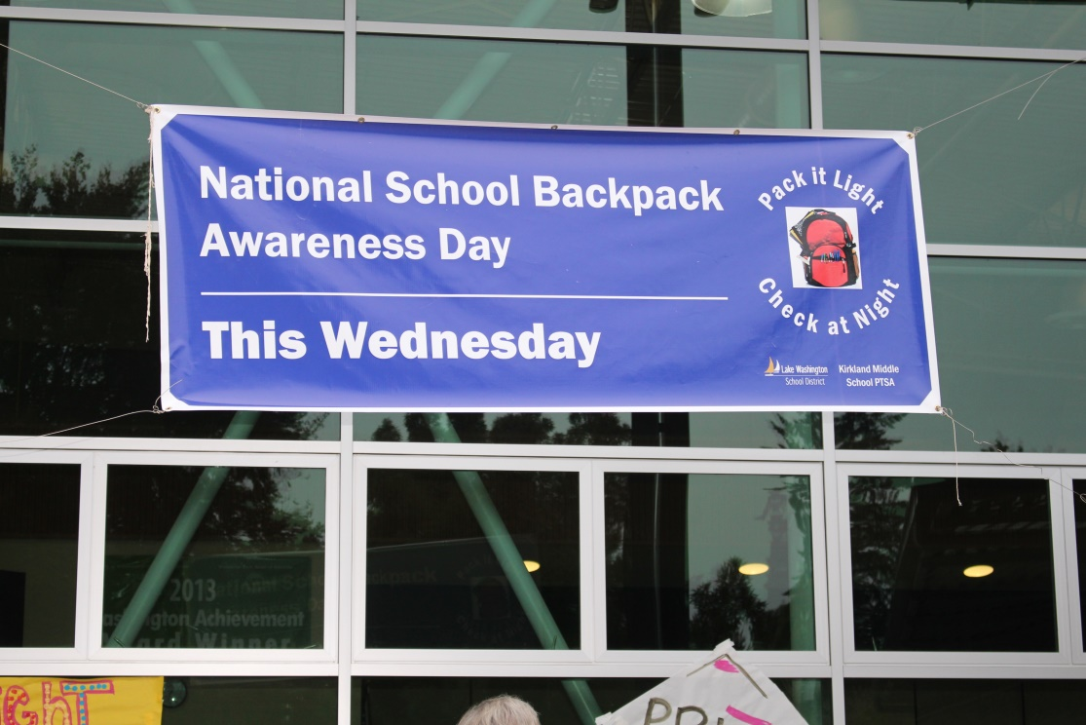
Welcome: Backpack Awareness Day Workshop
Tuesday, May 9th 10-11:30am
Redmond Public Library -Conference Room, 15990 NE 85th St., Redmond
Notes:
RSVP and encourage to join, email if you can’t make it but would like more info/materials

Slide 8
Backpack Awareness Day Toolkit:
Basic Plan/Decision Principles
Determine Event Date/Time/Location
Gain approval from PTSA Board and Principal
Assemble a planning committee
Invite Community Partners
Secure a Team of Volunteers
Communicate and Promote Event
Event Organization is important
Analyze and Communicate Results
Thank Volunteers and Community Participants

Slide 9
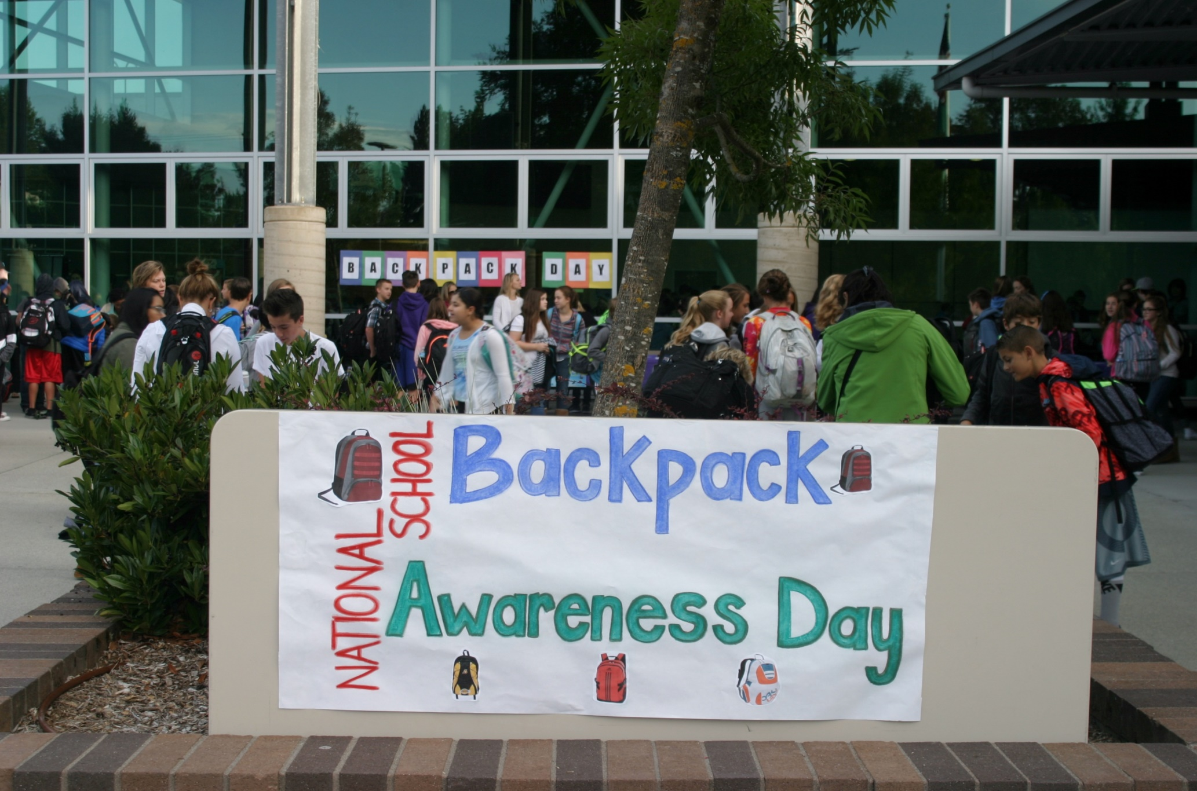

Slide 10
Day of Event: What Happens?
Timing
Location/Event Layout
Volunteers
Weighing Stations
Data Collection
Community Partnerships
Extra Credit-raffles/prizes/lunchtime

Slide 11
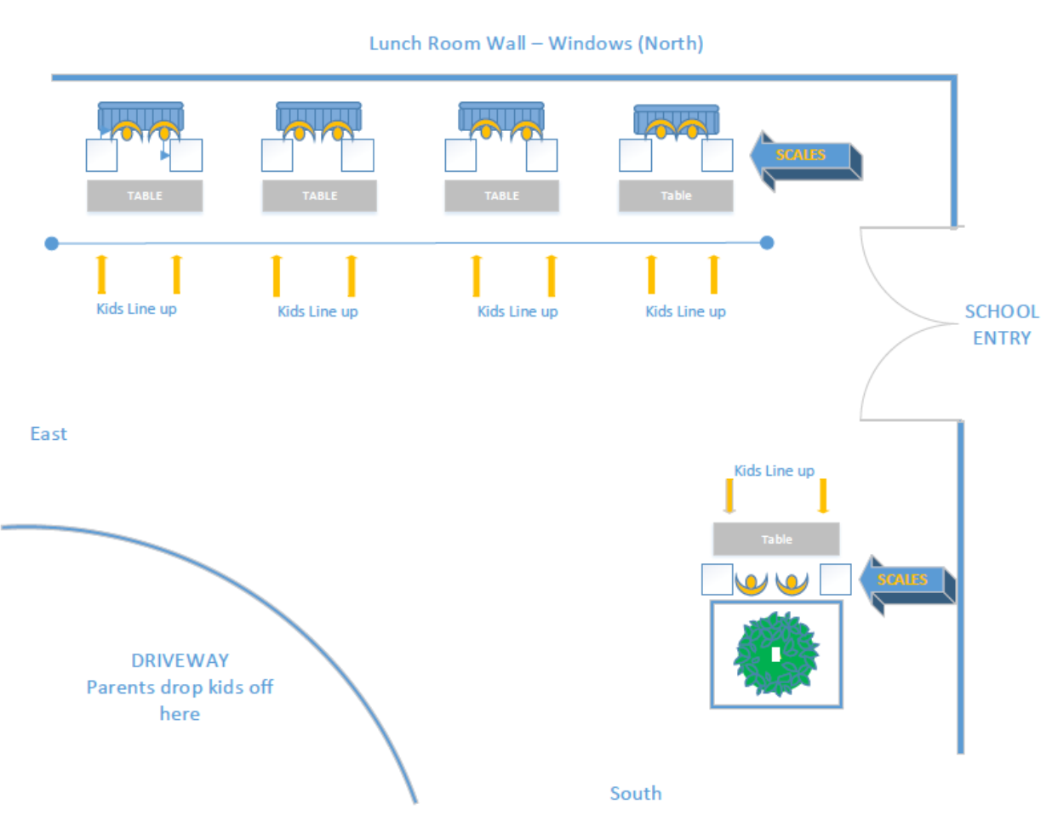
Event Layout

Slide 12
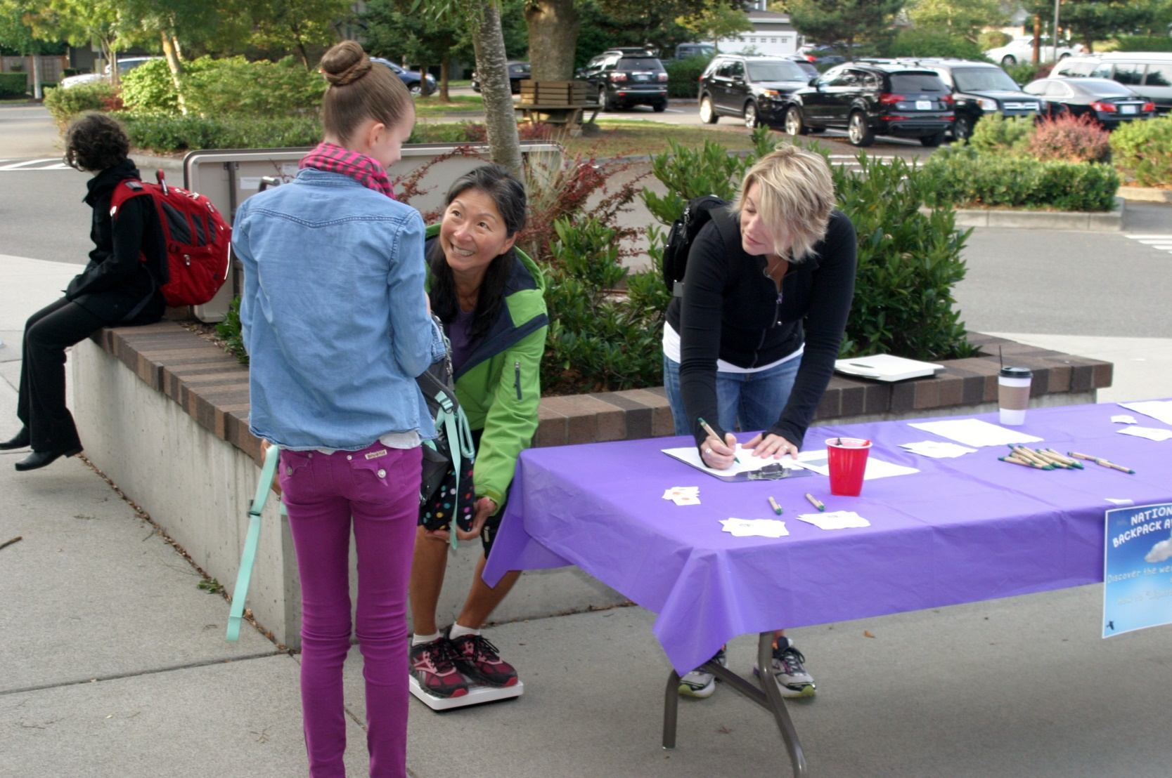
Weigh Stations

Slide 13
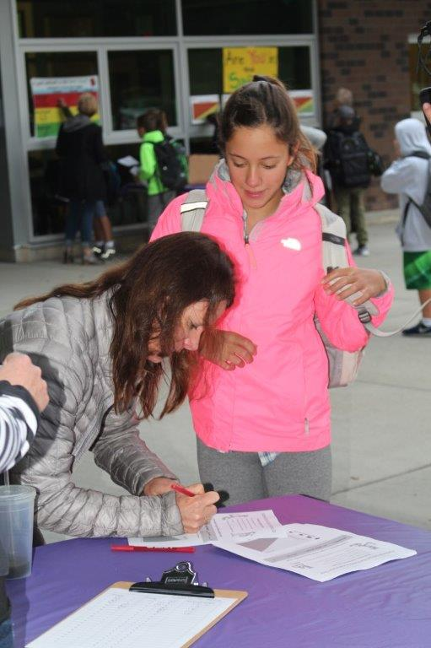

Slide 14
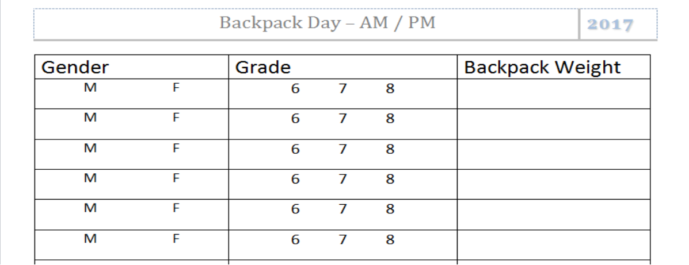
Data: For You & Your Students
Have enough copies at each station
Remember to NEVER weigh kids. Just their backpacks.
Data Collection Tool:

Slide 15
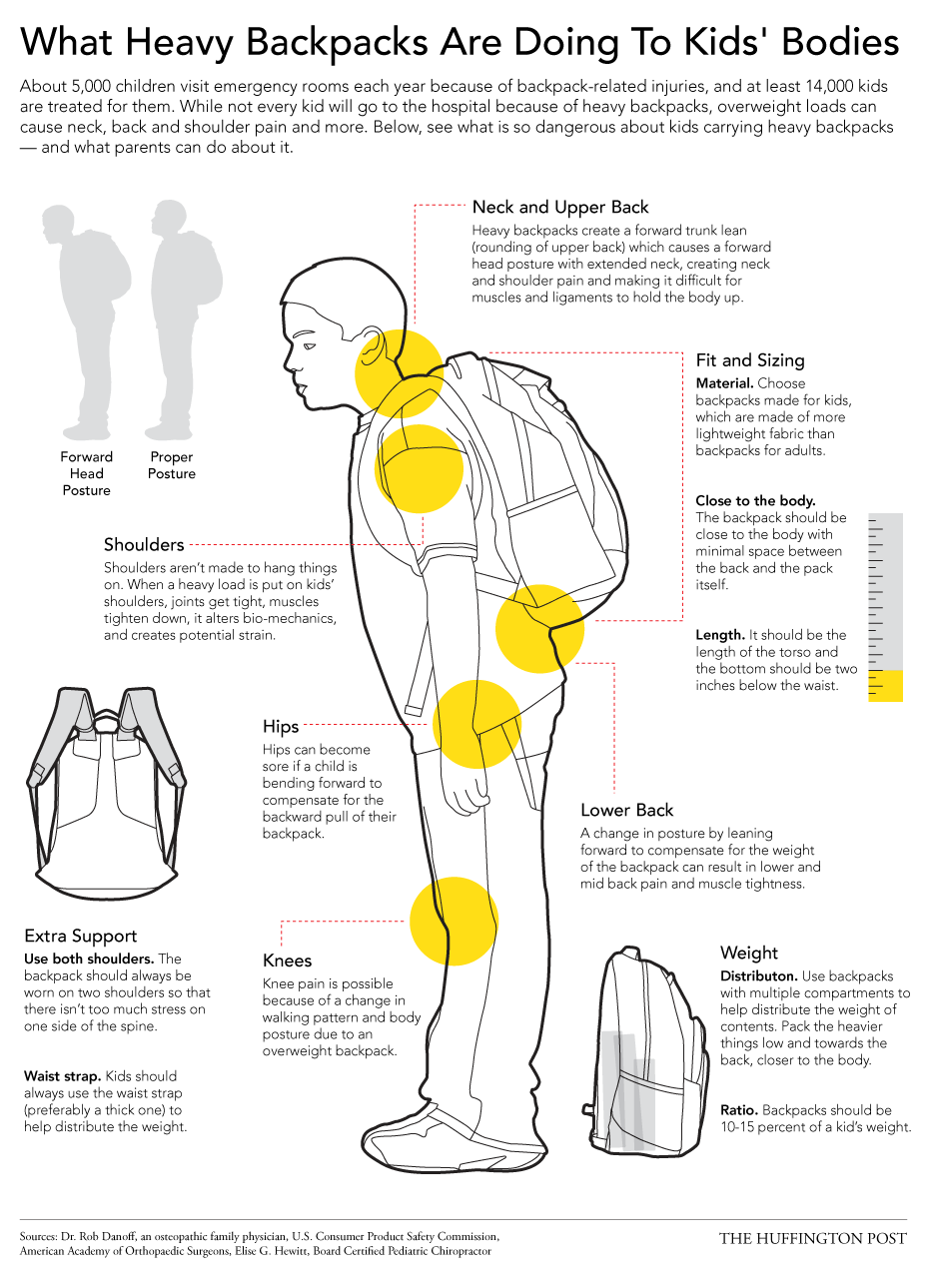
Student Handout

Slide 16
Extra Volunteers at the BMI Graph
 |  |  | BACKPACK % OF BODY WEIGHT |  |  |  |  |  |  |  |  |  |  |  |  | BACKPACK % OF BODY WEIGHT |  |  |  |  |  |  |  |  |  |  |  | BACKPACK % OF BODY WEIGHT
40 | 66.7% | 61.5% | 57.1% | 53.3% | 50.0% | 47.1% | 44.4% | 42.1% | 40.0% | 38.1% | 36.4% | 34.8% | 33.3% | 32.0% | 30.8% | 29.6% | 28.6% | 27.6% | 26.7% | 25.8% | 25.0% | 24.2% | 23.5% | 22.9% | 22.2% | 21.6% | 21.1% | 20.5% | 20.0% | 19.5% | 19.0% | 18.6% | 18.2% | 17.8%
39 | 65.0% | 60.0% | 55.7% | 52.0% | 48.8% | 45.9% | 43.3% | 41.1% | 39.0% | 37.1% | 35.5% | 33.9% | 32.5% | 31.2% | 30.0% | 28.9% | 27.9% | 26.9% | 26.0% | 25.2% | 24.4% | 23.6% | 22.9% | 22.3% | 21.7% | 21.1% | 20.5% | 20.0% | 19.5% | 19.0% | 18.6% | 18.1% | 17.7% | 17.3%
38 | 63.3% | 58.5% | 54.3% | 50.7% | 47.5% | 44.7% | 42.2% | 40.0% | 38.0% | 36.2% | 34.5% | 33.0% | 31.7% | 30.4% | 29.2% | 28.1% | 27.1% | 26.2% | 25.3% | 24.5% | 23.8% | 23.0% | 22.4% | 21.7% | 21.1% | 20.5% | 20.0% | 19.5% | 19.0% | 18.5% | 18.1% | 17.7% | 17.3% | 16.9%
37 | 61.7% | 56.9% | 52.9% | 49.3% | 46.3% | 43.5% | 41.1% | 38.9% | 37.0% | 35.2% | 33.6% | 32.2% | 30.8% | 29.6% | 28.5% | 27.4% | 26.4% | 25.5% | 24.7% | 23.9% | 23.1% | 22.4% | 21.8% | 21.1% | 20.6% | 20.0% | 19.5% | 19.0% | 18.5% | 18.0% | 17.6% | 17.2% | 16.8% | 16.4%
36 | 60.0% | 55.4% | 51.4% | 48.0% | 45.0% | 42.4% | 40.0% | 37.9% | 36.0% | 34.3% | 32.7% | 31.3% | 30.0% | 28.8% | 27.7% | 26.7% | 25.7% | 24.8% | 24.0% | 23.2% | 22.5% | 21.8% | 21.2% | 20.6% | 20.0% | 19.5% | 18.9% | 18.5% | 18.0% | 17.6% | 17.1% | 16.7% | 16.4% | 16.0%
35 | 58.3% | 53.8% | 50.0% | 46.7% | 43.8% | 41.2% | 38.9% | 36.8% | 35.0% | 33.3% | 31.8% | 30.4% | 29.2% | 28.0% | 26.9% | 25.9% | 25.0% | 24.1% | 23.3% | 22.6% | 21.9% | 21.2% | 20.6% | 20.0% | 19.4% | 18.9% | 18.4% | 17.9% | 17.5% | 17.1% | 16.7% | 16.3% | 15.9% | 15.6%
34 | 56.7% | 52.3% | 48.6% | 45.3% | 42.5% | 40.0% | 37.8% | 35.8% | 34.0% | 32.4% | 30.9% | 29.6% | 28.3% | 27.2% | 26.2% | 25.2% | 24.3% | 23.4% | 22.7% | 21.9% | 21.3% | 20.6% | 20.0% | 19.4% | 18.9% | 18.4% | 17.9% | 17.4% | 17.0% | 16.6% | 16.2% | 15.8% | 15.5% | 15.1%
33 | 55.0% | 50.8% | 47.1% | 44.0% | 41.3% | 38.8% | 36.7% | 34.7% | 33.0% | 31.4% | 30.0% | 28.7% | 27.5% | 26.4% | 25.4% | 24.4% | 23.6% | 22.8% | 22.0% | 21.3% | 20.6% | 20.0% | 19.4% | 18.9% | 18.3% | 17.8% | 17.4% | 16.9% | 16.5% | 16.1% | 15.7% | 15.3% | 15.0% | 14.7%
32 | 53.3% | 49.2% | 45.7% | 42.7% | 40.0% | 37.6% | 35.6% | 33.7% | 32.0% | 30.5% | 29.1% | 27.8% | 26.7% | 25.6% | 24.6% | 23.7% | 22.9% | 22.1% | 21.3% | 20.6% | 20.0% | 19.4% | 18.8% | 18.3% | 17.8% | 17.3% | 16.8% | 16.4% | 16.0% | 15.6% | 15.2% | 14.9% | 14.5% | 14.2%
31 | 51.7% | 47.7% | 44.3% | 41.3% | 38.8% | 36.5% | 34.4% | 32.6% | 31.0% | 29.5% | 28.2% | 27.0% | 25.8% | 24.8% | 23.8% | 23.0% | 22.1% | 21.4% | 20.7% | 20.0% | 19.4% | 18.8% | 18.2% | 17.7% | 17.2% | 16.8% | 16.3% | 15.9% | 15.5% | 15.1% | 14.8% | 14.4% | 14.1% | 13.8%
30 | 50.0% | 46.2% | 42.9% | 40.0% | 37.5% | 35.3% | 33.3% | 31.6% | 30.0% | 28.6% | 27.3% | 26.1% | 25.0% | 24.0% | 23.1% | 22.2% | 21.4% | 20.7% | 20.0% | 19.4% | 18.8% | 18.2% | 17.6% | 17.1% | 16.7% | 16.2% | 15.8% | 15.4% | 15.0% | 14.6% | 14.3% | 14.0% | 13.6% | 13.3%
29 | 48.3% | 44.6% | 41.4% | 38.7% | 36.3% | 34.1% | 32.2% | 30.5% | 29.0% | 27.6% | 26.4% | 25.2% | 24.2% | 23.2% | 22.3% | 21.5% | 20.7% | 20.0% | 19.3% | 18.7% | 18.1% | 17.6% | 17.1% | 16.6% | 16.1% | 15.7% | 15.3% | 14.9% | 14.5% | 14.1% | 13.8% | 13.5% | 13.2% | 12.9%
28 | 46.7% | 43.1% | 40.0% | 37.3% | 35.0% | 32.9% | 31.1% | 29.5% | 28.0% | 26.7% | 25.5% | 24.3% | 23.3% | 22.4% | 21.5% | 20.7% | 20.0% | 19.3% | 18.7% | 18.1% | 17.5% | 17.0% | 16.5% | 16.0% | 15.6% | 15.1% | 14.7% | 14.4% | 14.0% | 13.7% | 13.3% | 13.0% | 12.7% | 12.4%
27 | 45.0% | 41.5% | 38.6% | 36.0% | 33.8% | 31.8% | 30.0% | 28.4% | 27.0% | 25.7% | 24.5% | 23.5% | 22.5% | 21.6% | 20.8% | 20.0% | 19.3% | 18.6% | 18.0% | 17.4% | 16.9% | 16.4% | 15.9% | 15.4% | 15.0% | 14.6% | 14.2% | 13.8% | 13.5% | 13.2% | 12.9% | 12.6% | 12.3% | 12.0%
26 | 43.3% | 40.0% | 37.1% | 34.7% | 32.5% | 30.6% | 28.9% | 27.4% | 26.0% | 24.8% | 23.6% | 22.6% | 21.7% | 20.8% | 20.0% | 19.3% | 18.6% | 17.9% | 17.3% | 16.8% | 16.3% | 15.8% | 15.3% | 14.9% | 14.4% | 14.1% | 13.7% | 13.3% | 13.0% | 12.7% | 12.4% | 12.1% | 11.8% | 11.6%
25 | 41.7% | 38.5% | 35.7% | 33.3% | 31.3% | 29.4% | 27.8% | 26.3% | 25.0% | 23.8% | 22.7% | 21.7% | 20.8% | 20.0% | 19.2% | 18.5% | 17.9% | 17.2% | 16.7% | 16.1% | 15.6% | 15.2% | 14.7% | 14.3% | 13.9% | 13.5% | 13.2% | 12.8% | 12.5% | 12.2% | 11.9% | 11.6% | 11.4% | 11.1%
24 | 40.0% | 36.9% | 34.3% | 32.0% | 30.0% | 28.2% | 26.7% | 25.3% | 24.0% | 22.9% | 21.8% | 20.9% | 20.0% | 19.2% | 18.5% | 17.8% | 17.1% | 16.6% | 16.0% | 15.5% | 15.0% | 14.5% | 14.1% | 13.7% | 13.3% | 13.0% | 12.6% | 12.3% | 12.0% | 11.7% | 11.4% | 11.2% | 10.9% | 10.7%
23 | 38.3% | 35.4% | 32.9% | 30.7% | 28.8% | 27.1% | 25.6% | 24.2% | 23.0% | 21.9% | 20.9% | 20.0% | 19.2% | 18.4% | 17.7% | 17.0% | 16.4% | 15.9% | 15.3% | 14.8% | 14.4% | 13.9% | 13.5% | 13.1% | 12.8% | 12.4% | 12.1% | 11.8% | 11.5% | 11.2% | 11.0% | 10.7% | 10.5% | 10.2%
22 | 36.7% | 33.8% | 31.4% | 29.3% | 27.5% | 25.9% | 24.4% | 23.2% | 22.0% | 21.0% | 20.0% | 19.1% | 18.3% | 17.6% | 16.9% | 16.3% | 15.7% | 15.2% | 14.7% | 14.2% | 13.8% | 13.3% | 12.9% | 12.6% | 12.2% | 11.9% | 11.6% | 11.3% | 11.0% | 10.7% | 10.5% | 10.2% | 10.0% | 9.8%
21 | 35.0% | 32.3% | 30.0% | 28.0% | 26.3% | 24.7% | 23.3% | 22.1% | 21.0% | 20.0% | 19.1% | 18.3% | 17.5% | 16.8% | 16.2% | 15.6% | 15.0% | 14.5% | 14.0% | 13.5% | 13.1% | 12.7% | 12.4% | 12.0% | 11.7% | 11.4% | 11.1% | 10.8% | 10.5% | 10.2% | 10.0% | 9.8% | 9.5% | 9.3%
20 | 33.3% | 30.8% | 28.6% | 26.7% | 25.0% | 23.5% | 22.2% | 21.1% | 20.0% | 19.0% | 18.2% | 17.4% | 16.7% | 16.0% | 15.4% | 14.8% | 14.3% | 13.8% | 13.3% | 12.9% | 12.5% | 12.1% | 11.8% | 11.4% | 11.1% | 10.8% | 10.5% | 10.3% | 10.0% | 9.8% | 9.5% | 9.3% | 9.1% | 8.9%
19 | 31.7% | 29.2% | 27.1% | 25.3% | 23.8% | 22.4% | 21.1% | 20.0% | 19.0% | 18.1% | 17.3% | 16.5% | 15.8% | 15.2% | 14.6% | 14.1% | 13.6% | 13.1% | 12.7% | 12.3% | 11.9% | 11.5% | 11.2% | 10.9% | 10.6% | 10.3% | 10.0% | 9.7% | 9.5% | 9.3% | 9.0% | 8.8% | 8.6% | 8.4%
18 | 30.0% | 27.7% | 25.7% | 24.0% | 22.5% | 21.2% | 20.0% | 18.9% | 18.0% | 17.1% | 16.4% | 15.7% | 15.0% | 14.4% | 13.8% | 13.3% | 12.9% | 12.4% | 12.0% | 11.6% | 11.3% | 10.9% | 10.6% | 10.3% | 10.0% | 9.7% | 9.5% | 9.2% | 9.0% | 8.8% | 8.6% | 8.4% | 8.2% | 8.0%
17 | 28.3% | 26.2% | 24.3% | 22.7% | 21.3% | 20.0% | 18.9% | 17.9% | 17.0% | 16.2% | 15.5% | 14.8% | 14.2% | 13.6% | 13.1% | 12.6% | 12.1% | 11.7% | 11.3% | 11.0% | 10.6% | 10.3% | 10.0% | 9.7% | 9.4% | 9.2% | 8.9% | 8.7% | 8.5% | 8.3% | 8.1% | 7.9% | 7.7% | 7.6%
16 | 26.7% | 24.6% | 22.9% | 21.3% | 20.0% | 18.8% | 17.8% | 16.8% | 16.0% | 15.2% | 14.5% | 13.9% | 13.3% | 12.8% | 12.3% | 11.9% | 11.4% | 11.0% | 10.7% | 10.3% | 10.0% | 9.7% | 9.4% | 9.1% | 8.9% | 8.6% | 8.4% | 8.2% | 8.0% | 7.8% | 7.6% | 7.4% | 7.3% | 7.1%
15 | 25.0% | 23.1% | 21.4% | 20.0% | 18.8% | 17.6% | 16.7% | 15.8% | 15.0% | 14.3% | 13.6% | 13.0% | 12.5% | 12.0% | 11.5% | 11.1% | 10.7% | 10.3% | 10.0% | 9.7% | 9.4% | 9.1% | 8.8% | 8.6% | 8.3% | 8.1% | 7.9% | 7.7% | 7.5% | 7.3% | 7.1% | 7.0% | 6.8% | 6.7%
14 | 23.3% | 21.5% | 20.0% | 18.7% | 17.5% | 16.5% | 15.6% | 14.7% | 14.0% | 13.3% | 12.7% | 12.2% | 11.7% | 11.2% | 10.8% | 10.4% | 10.0% | 9.7% | 9.3% | 9.0% | 8.8% | 8.5% | 8.2% | 8.0% | 7.8% | 7.6% | 7.4% | 7.2% | 7.0% | 6.8% | 6.7% | 6.5% | 6.4% | 6.2%
13 | 21.7% | 20.0% | 18.6% | 17.3% | 16.3% | 15.3% | 14.4% | 13.7% | 13.0% | 12.4% | 11.8% | 11.3% | 10.8% | 10.4% | 10.0% | 9.6% | 9.3% | 9.0% | 8.7% | 8.4% | 8.1% | 7.9% | 7.6% | 7.4% | 7.2% | 7.0% | 6.8% | 6.7% | 6.5% | 6.3% | 6.2% | 6.0% | 5.9% | 5.8%
12 | 20.0% | 18.5% | 17.1% | 16.0% | 15.0% | 14.1% | 13.3% | 12.6% | 12.0% | 11.4% | 10.9% | 10.4% | 10.0% | 9.6% | 9.2% | 8.9% | 8.6% | 8.3% | 8.0% | 7.7% | 7.5% | 7.3% | 7.1% | 6.9% | 6.7% | 6.5% | 6.3% | 6.2% | 6.0% | 5.9% | 5.7% | 5.6% | 5.5% | 5.3%
11 | 18.3% | 16.9% | 15.7% | 14.7% | 13.8% | 12.9% | 12.2% | 11.6% | 11.0% | 10.5% | 10.0% | 9.6% | 9.2% | 8.8% | 8.5% | 8.1% | 7.9% | 7.6% | 7.3% | 7.1% | 6.9% | 6.7% | 6.5% | 6.3% | 6.1% | 5.9% | 5.8% | 5.6% | 5.5% | 5.4% | 5.2% | 5.1% | 5.0% | 4.9%
10 | 16.7% | 15.4% | 14.3% | 13.3% | 12.5% | 11.8% | 11.1% | 10.5% | 10.0% | 9.5% | 9.1% | 8.7% | 8.3% | 8.0% | 7.7% | 7.4% | 7.1% | 6.9% | 6.7% | 6.5% | 6.3% | 6.1% | 5.9% | 5.7% | 5.6% | 5.4% | 5.3% | 5.1% | 5.0% | 4.9% | 4.8% | 4.7% | 4.5% | 4.4%
 | 60 | 65 | 70 | 75 | 80 | 85 | 90 | 95 | 100 | 105 | 110 | 115 | 120 | 125 | 130 | 135 | 140 | 145 | 150 | 155 | 160 | 165 | 170 | 175 | 180 | 185 | 190 | 195 | 200 | 205 | 210 | 215 | 220 | 225
 |  |  |  | BODY WEIGHT |  |  |  |  |  |  |  |  |  |  |  |  |  | BODY WEIGHT |  |  |  |  |  |  |  |  |  |  |  | BODY WEIGHT

Slide 17
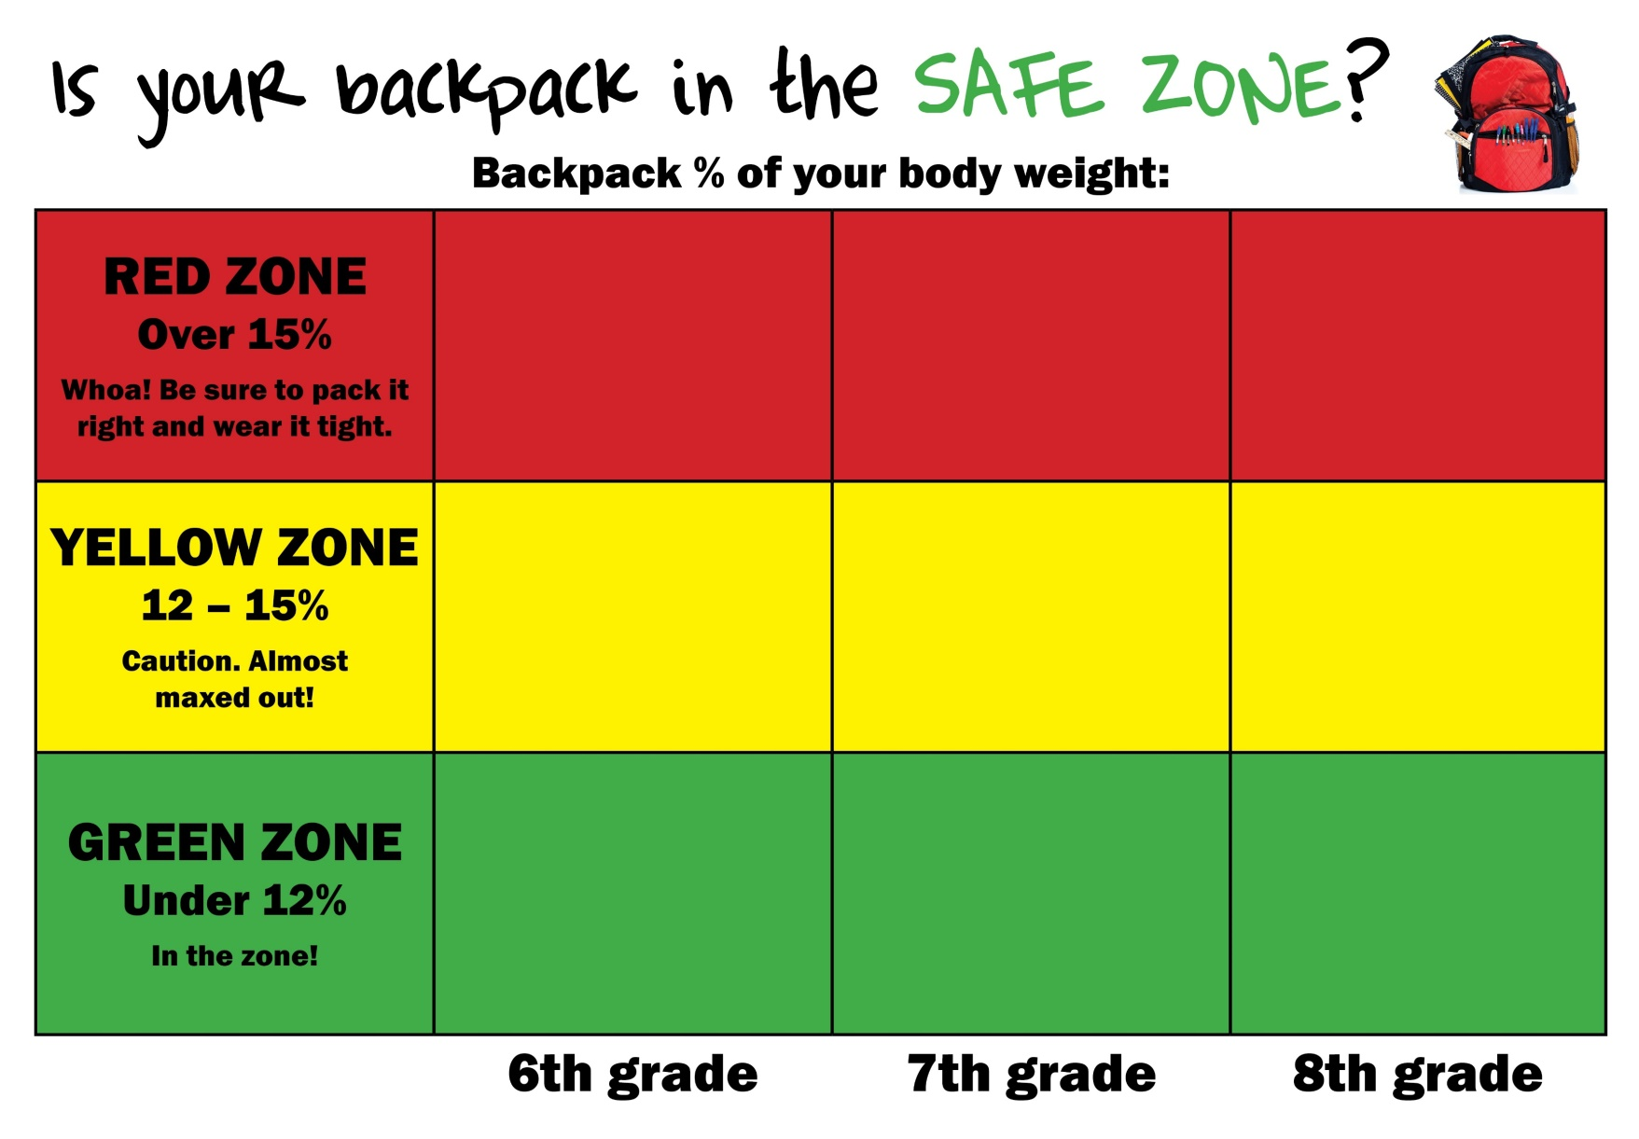
Sticker Chart

Slide 18
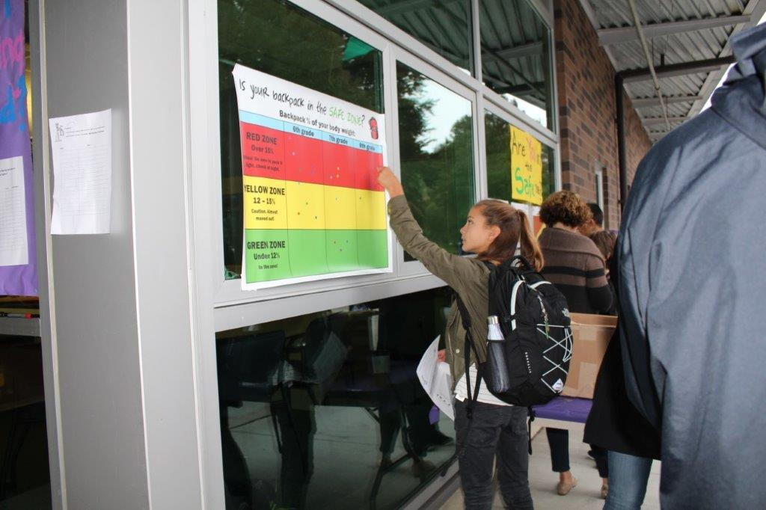
Kids Find Their “Zone”

Slide 19
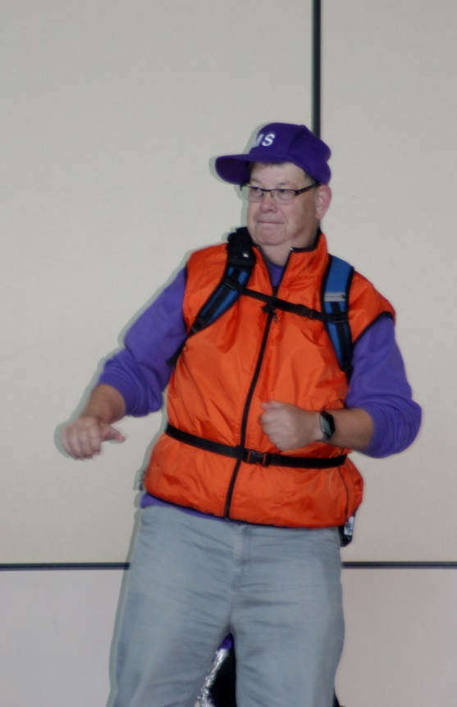
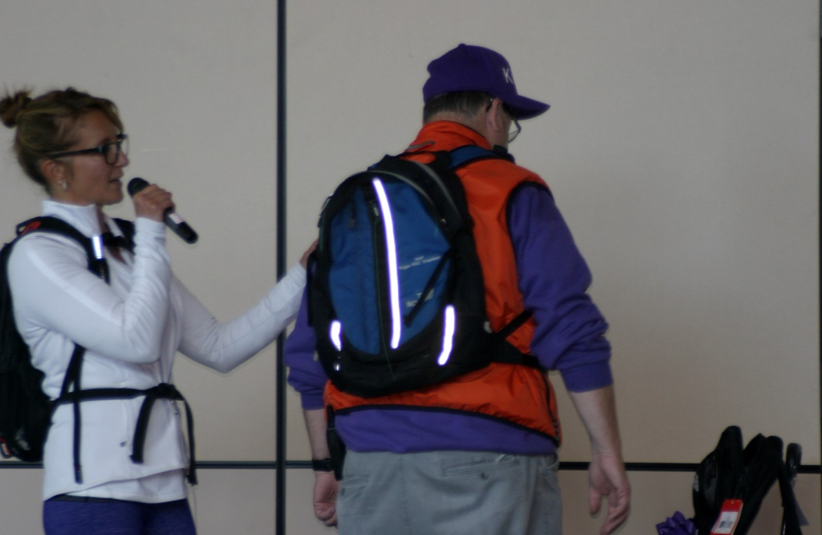
Lunchtime Presentation- Make it Fun!

Slide 20
Post Event
Data Analysis
  Spreadsheet w/formulas
Sharing what you’ve learned
  School admin, PTSA, families, LWSD, and the kids
Plan on event for next year to compare/gauge progress
Create Next Steps for Your School
  Why are they heavy?
  What can be changed at a school level?
  How can we team towards common goals w/district support?

Slide 21


How to input collected data
This data is formula driven and it calculates:
Weight of the BP as a % of kid’s body weight
This data is collected during Back Pack Awareness Day

Slide 22
Count up your reds and greens

Slide 24
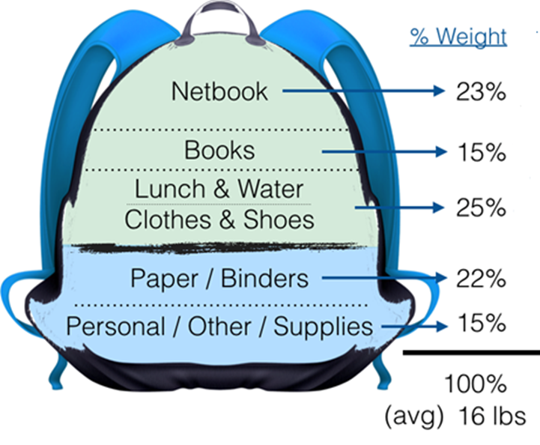
Are your backpacks too heavy?
Why?

Slide 25
Questions & Answers
All of this info and materials can be found:
http://kirklandmiddleptsa.org/Page/Pta/Backpack

